Slide 1
Overview of SAM
Version A.01
H3064S Module 2 Slides

Slide 2
Why Use SAM?
Advantages
Simplifies complex administration tasks
Minimizes potential for errors
Provides a built-in help utility
Disadvantages
Is less flexible than manual configuration
Is not helpful in some troubleshooting situations
a6692

Slide 3
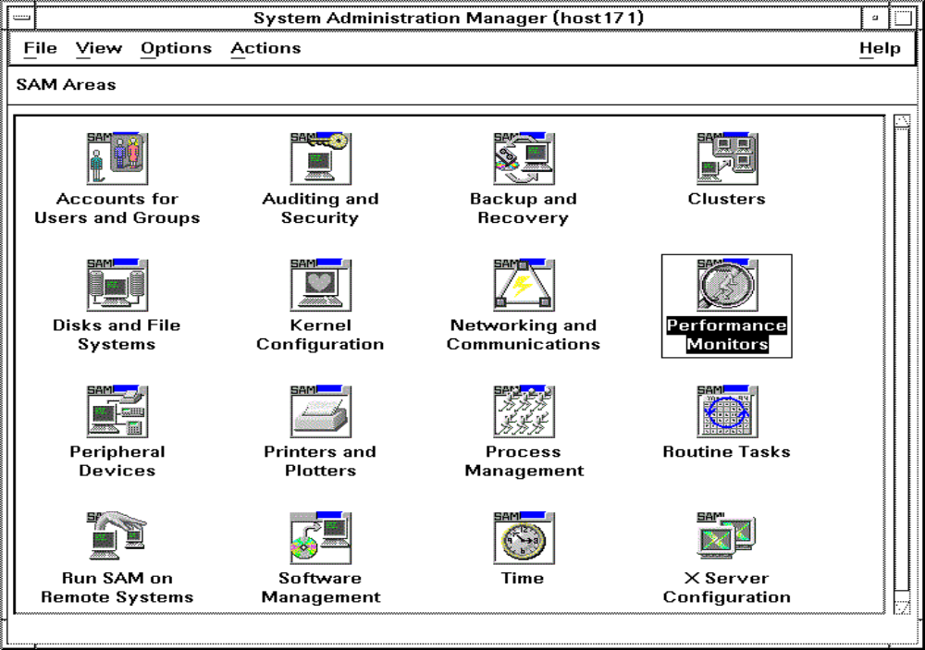
Using the SAM GUI
Menu Bar
Status Bar
Functional Area
Icons
Scroll Bar
a6693

Slide 4
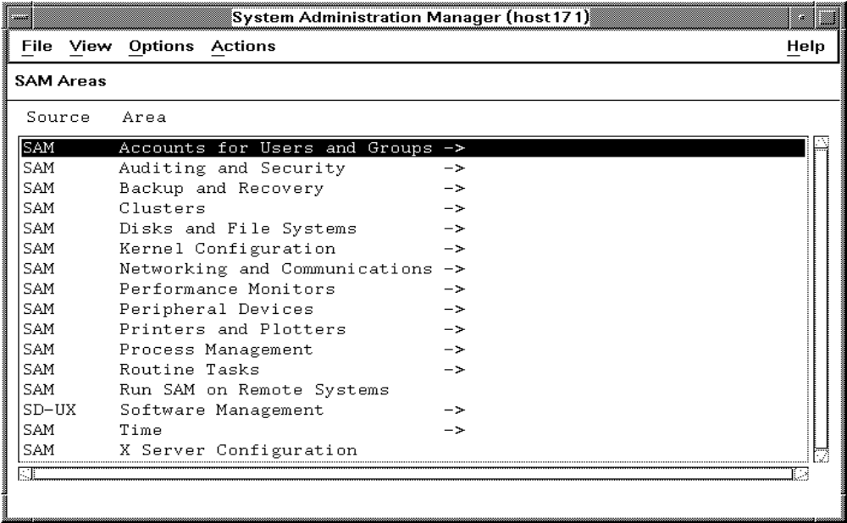
Using the SAM Terminal Interface
a6694

